Slide 1
Java Virtual Threads
Robert Jacko

Slide 2
Project Loom
easy-to-use, high-throughput lightweight concurrency (first commit 2007)
JEP 444: Virtual Threads
https://openjdk.org/jeps/444
JEP 428: Structured Concurrency
https://openjdk.org/jeps/428
Notes:
MORE SLIDES WITH INDUSTRY-FOCUSED QUOTES HERE https://docs.google.com/presentation/d/1e5y4GJkNKxx8CFskI8DZQxiXBjCOHh70YYprnuxt-98/edit?usp=sharing

Slide 3
Thread
construct of operating system (1967) to achieve concurrency
large stack and other resources that are maintained by the operating system – expensive context switching
process vs thread
Notes:
MORE SLIDES WITH INDUSTRY-FOCUSED QUOTES HERE https://docs.google.com/presentation/d/1e5y4GJkNKxx8CFskI8DZQxiXBjCOHh70YYprnuxt-98/edit?usp=sharing

Slide 4
Threads in Java
java.lang.Thread
since 1.0
mapped 1:1 to kernel threads scheduled by the operating system
Runnable 1.0 vs Callable 1.5
new Thread(() -> System.out.println("I am alive")).start();
Notes:
MORE SLIDES WITH INDUSTRY-FOCUSED QUOTES HERE https://docs.google.com/presentation/d/1e5y4GJkNKxx8CFskI8DZQxiXBjCOHh70YYprnuxt-98/edit?usp=sharing

Slide 5
Virtual Threads
Java 19 preview, Java 20 second preview, Java 21!
JVM construct
platform thread vs virtual thread
java.lang.VirtualThread
Thread -> BaseVirtualThread -> VirtualThread
default scheduler - ForkJoinPool
Notes:
MORE SLIDES WITH INDUSTRY-FOCUSED QUOTES HERE https://docs.google.com/presentation/d/1e5y4GJkNKxx8CFskI8DZQxiXBjCOHh70YYprnuxt-98/edit?usp=sharing

Slide 6
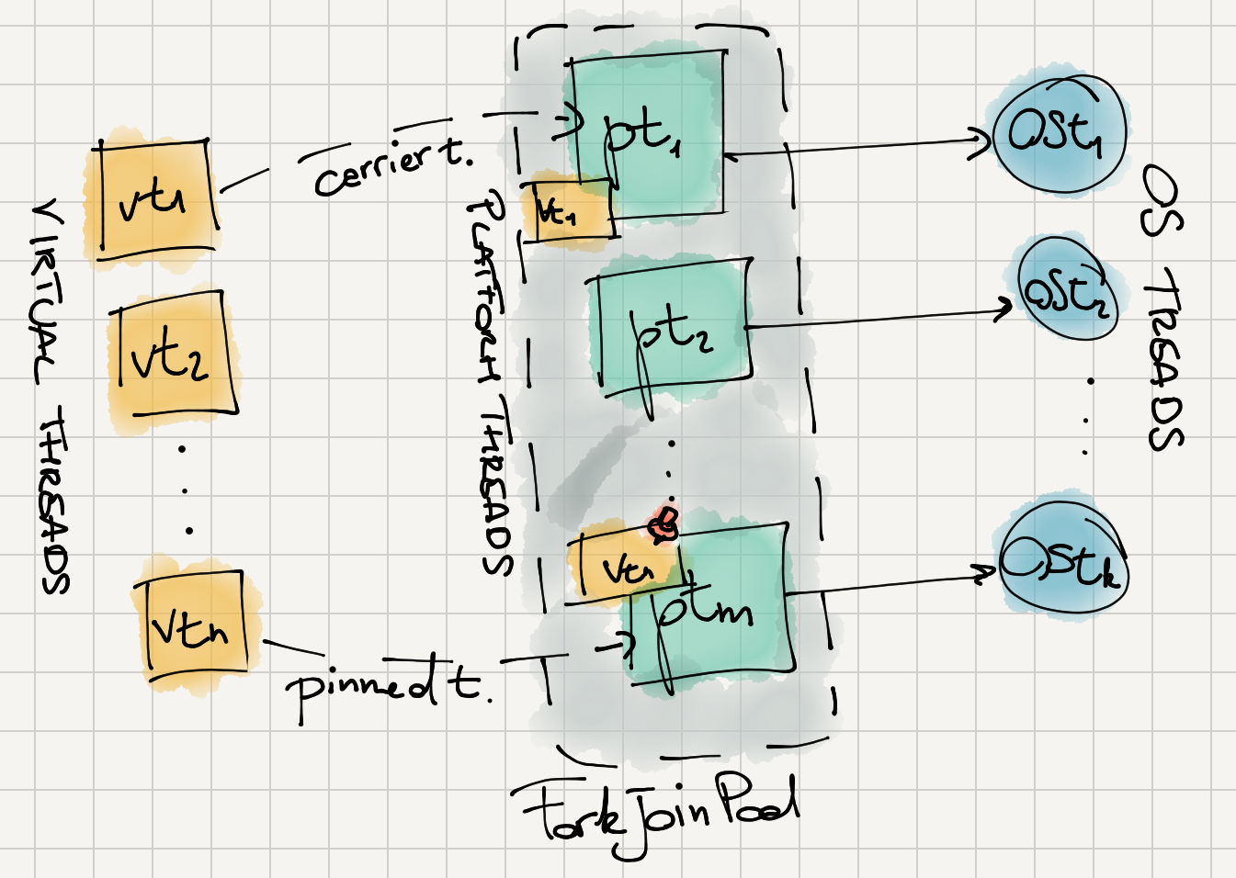
Virtual Threads
Notes:
MORE SLIDES WITH INDUSTRY-FOCUSED QUOTES HERE https://docs.google.com/presentation/d/1e5y4GJkNKxx8CFskI8DZQxiXBjCOHh70YYprnuxt-98/edit?usp=sharing

Slide 7
Virtual Threads
Thread.startVirtualThread(runnable);
Thread.ofVirtual().name(name).start(runnable);
try (var executor = Executors.newVirtualThreadPerTaskExecutor()) { executor.submit(() -> { System.out.println("I am virtual and alive."); }); }
Notes:
MORE SLIDES WITH INDUSTRY-FOCUSED QUOTES HERE https://docs.google.com/presentation/d/1e5y4GJkNKxx8CFskI8DZQxiXBjCOHh70YYprnuxt-98/edit?usp=sharing

Slide 8
Virtual Threads
final ThreadFactory factory = Thread.ofVirtual().factory(); try (var executor = Executors.newThreadPerTaskExecutor(factory)) { executor.submit(() -> { System.out.println("I am virtual and alive."); }); }
Notes:
MORE SLIDES WITH INDUSTRY-FOCUSED QUOTES HERE https://docs.google.com/presentation/d/1e5y4GJkNKxx8CFskI8DZQxiXBjCOHh70YYprnuxt-98/edit?usp=sharing

Slide 9
Advantages
JVM schedules execution not the system
less resources, faster context switching
(almost) no blocking operations
virtual threads vs reactive programming
increased throughput
Notes:
MORE SLIDES WITH INDUSTRY-FOCUSED QUOTES HERE https://docs.google.com/presentation/d/1e5y4GJkNKxx8CFskI8DZQxiXBjCOHh70YYprnuxt-98/edit?usp=sharing

Slide 10
Limitations
concurrency and performance based on CPUs/cores
synchronized blocks
replace by ReentrantLock, ReadWriteReentrantLock, StampedLock
native method or a foreign function (JNI)
ThreadLocal
platform threads are the default
Notes:
MORE SLIDES WITH INDUSTRY-FOCUSED QUOTES HERE https://docs.google.com/presentation/d/1e5y4GJkNKxx8CFskI8DZQxiXBjCOHh70YYprnuxt-98/edit?usp=sharing

Slide 11
Let’s see some code
https://github.com/robo-jacko/virtual_threads
Notes:
MORE SLIDES WITH INDUSTRY-FOCUSED QUOTES HERE https://docs.google.com/presentation/d/1e5y4GJkNKxx8CFskI8DZQxiXBjCOHh70YYprnuxt-98/edit?usp=sharing

Slide 12
Virtual Threads Support
Helidon Níma
Spring Boot
Tomcat
Quarkus
…
Notes:
MORE SLIDES WITH INDUSTRY-FOCUSED QUOTES HERE https://docs.google.com/presentation/d/1e5y4GJkNKxx8CFskI8DZQxiXBjCOHh70YYprnuxt-98/edit?usp=sharing

Slide 13
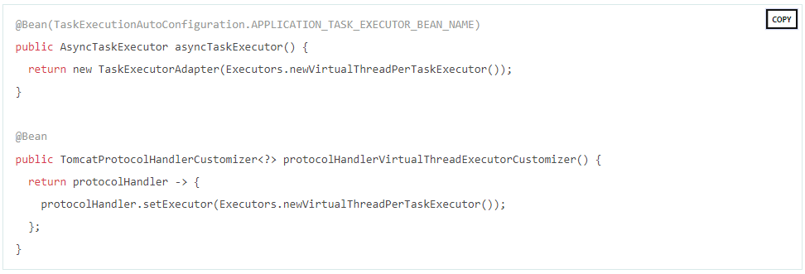
Virtual Threads Support
Spring Boot
Notes:
MORE SLIDES WITH INDUSTRY-FOCUSED QUOTES HERE https://docs.google.com/presentation/d/1e5y4GJkNKxx8CFskI8DZQxiXBjCOHh70YYprnuxt-98/edit?usp=sharing

Slide 14
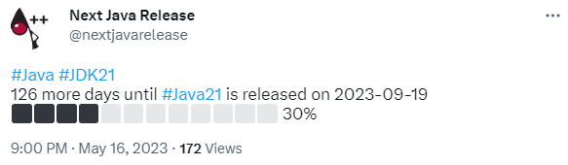
Java 21
Notes:
MORE SLIDES WITH INDUSTRY-FOCUSED QUOTES HERE https://docs.google.com/presentation/d/1e5y4GJkNKxx8CFskI8DZQxiXBjCOHh70YYprnuxt-98/edit?usp=sharing

Slide 15
Questions?

Slide 16
References
JEP 444: Virtual Threads
https://openjdk.org/jeps/444
JEP 453: Structured Concurrency
https://openjdk.org/jeps/453
The Ultimate Guide to Java Virtual Threads
https://blog.rockthejvm.com/ultimate-guide-to-java-virtual-threads/
Notes:
MORE SLIDES WITH INDUSTRY-FOCUSED QUOTES HERE https://docs.google.com/presentation/d/1e5y4GJkNKxx8CFskI8DZQxiXBjCOHh70YYprnuxt-98/edit?usp=sharing

Slide 17
References
Kotlin Coroutines vs Java Virtual Threads
https://itnext.io/kotlin-coroutines-vs-java-virtual-threads-a-good-story-but-just-that-91038c7d21eb
WRITING SIMPLER REACTIVE REST SERVICES WITH QUARKUS VIRTUAL THREAD SUPPORT
https://quarkus.io/guides/virtual-threads
https://github.com/robo-jacko/virtual_threads
Notes:
MORE SLIDES WITH INDUSTRY-FOCUSED QUOTES HERE https://docs.google.com/presentation/d/1e5y4GJkNKxx8CFskI8DZQxiXBjCOHh70YYprnuxt-98/edit?usp=sharing

